Slide 1
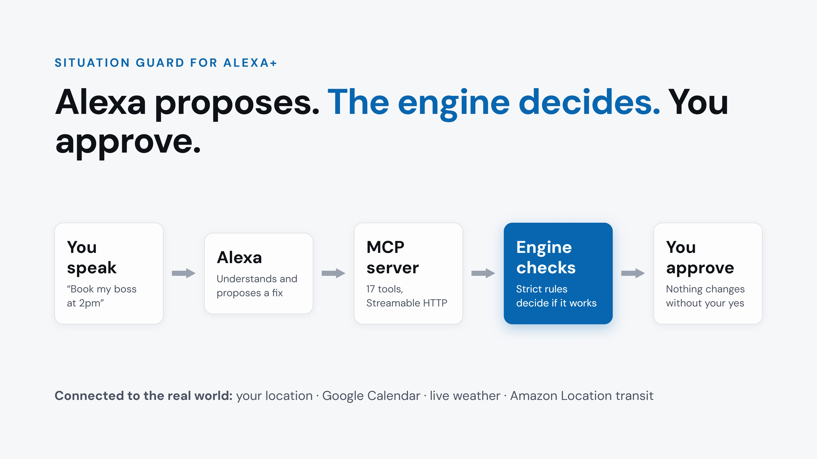
Notes:
Situation Guard is a self-hosted MCP server for Alexa+, with 17 tools. Alexa proposes, a deterministic engine decides, and nothing changes until you say yes. It’s connected to the real world: my location, my Google Calendar, live weather, and real public transport from Amazon Location.

